Slide 1
CAPSTONE PROJECT
Data Analysis Using MySQL

Slide 2
PROJECT OBJECTIVE
The objective of the project is to use MySQL to analyze the data of a movie rental store for further growth and improved business.

Slide 3
MOVIE RENTAL DATA ANALYSIS
MovieOnRent is a chain of movie rental stores operating in a certain country. It has a vast collection of movies in DVD and Blue Ray disc formats. The management of the company wants to analyze what kind of movies are most often rented, which genres they belong to and which actors appeared in them. I will help the management to stock up the Inventory as per audience's preferences for Improved business. To begin with, the management has asked Luna, data analyst, to answer certain Questions by carrying out the upcoming tasks.
You are required to help Luna write queries to perform these tasks.
For the movie rental data, We’re using the Sakila Database.

Slide 4
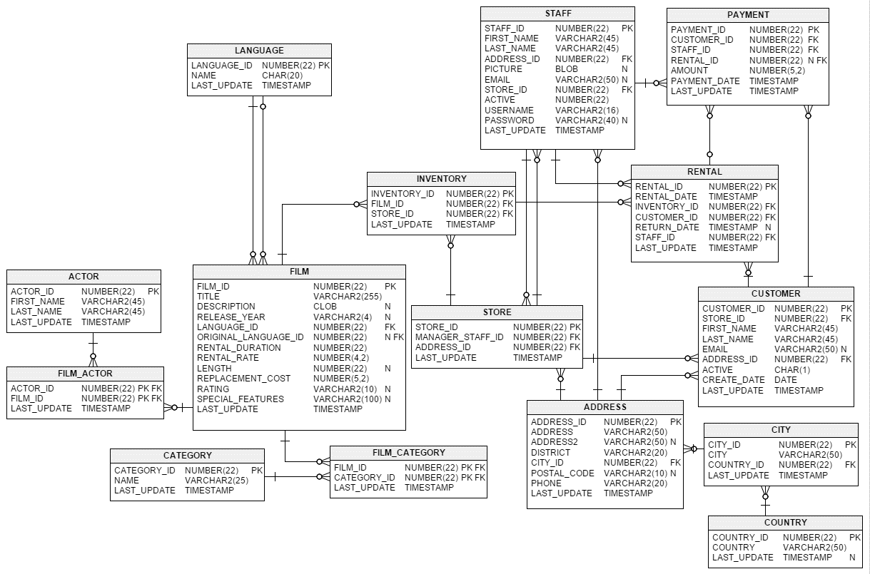
ER DIAGRAM

Slide 5
01
TASK

Slide 6
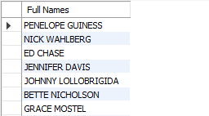
01
TASK
Display the full names of actors available in the database.

Slide 7
02
TASK

Slide 8

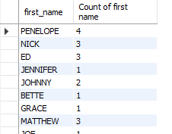
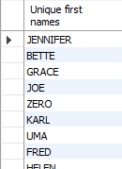
02
TASK
Management wants to know if there are any names of actors appearing frequently.
Display the number of times each first name appears in the database.
What is the count of actors that have unique first names in the database? Display the first names of all these actors.
i
ii

Slide 9
03
TASK

Slide 10
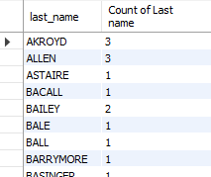
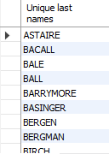
03
TASK
The management is interested to analyze the similarity in the last names of the actors.
Display the number of times each last name appears in the database.
Display all unique last names in the database.
i
ii

Slide 11
04
TASK

Slide 12
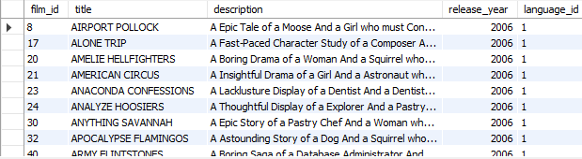
04
TASK
The management wants to analyze the movies based on their ratings to determine if they are suitable for kids or some parental assistance is required. Perform the following tasks to perform the required analysis.
Display the list of records for the movies with rating “R”. (The movies with rating “R” are not suitable for audience under 17 years of age)

Slide 13
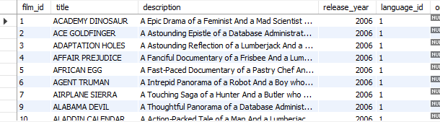
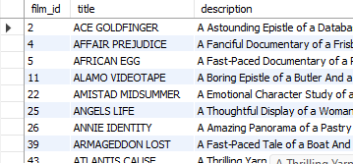
04
TASK
Display the list of records for movies that are not rated “R”
Display the list of records for the movies that are suitable for audience below 13 years of age.
ii
iii

Slide 14
05
TASK

Slide 15
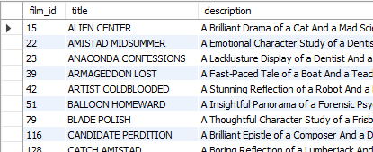
05
TASK
The board members want to understand the replacement cost of a movie copy (disc- DVD/Blue ray). The replacement cost refers to the amount charged to the customer if the movie disc is not returned or is returned in a damaged state.
Display the list of records for the movies where the replacement cost is up to $11.

Slide 16
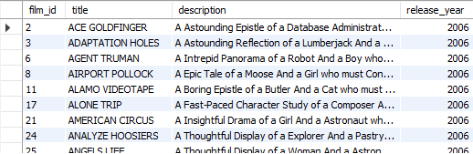
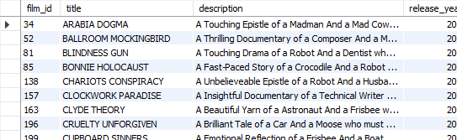
05
TASK
Display the list of records for the movies where the replacement cost is between $11 and $20.
Display the list of records for all the movies in descending order of their replacement cost.
ii
iii

Slide 17
06
TASK

Slide 18

06
TASK
Display the names of top 3 movies with greatest number of actors.

Slide 19
07
TASK

Slide 20
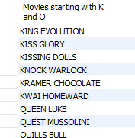
07
TASK
‘Music of Queen’ and ‘Kris Kristofferson’ have seen an unlikely resurgence. As an unintended consequence, films starting with the letters ‘K’ and ‘Q’ have also soared in popularity. Display the titles of the movies starting with the letters ‘K’ and ‘Q’.

Slide 21
08
TASK

Slide 22
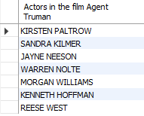
08
TASK
The film ‘Agent Truman’ has been a great success. Display the names of all actors who appeared in this film

Slide 23
09
TASK

Slide 24
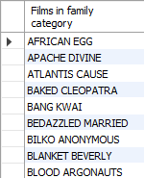
09
TASK
Sales have been lagging among young families, So the management wants to promote family movies. Identify all the movies categorized as family films.

Slide 25
10
TASK

Slide 26
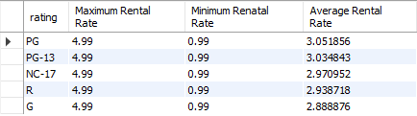
10
TASK
The management wants to observe the rental rate and rental frequencies( Number of times movie disc is rented).
Display the maximum, minimum and average rental rates of movies based on their ratings. The output must be sorted in descending order of the average rental rates.

Slide 27
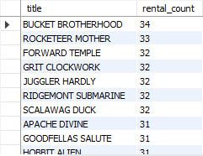
10
TASK
Display the movies in descending order of their rental frequencies, so the management can maintain more copies of those movies

Slide 28
11
TASK

Slide 29
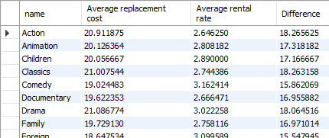
11
TASK
In how many film categories, the difference between the average film replacement cost and the average film rental rate is greater than $15?
Display the list of all the film categories identified above , along with corresponding average film replacement cost and average film rental rate.

Slide 30
12
TASK

Slide 31

12
TASK
Display the film categories in which the number of movies is greater than 70.

Slide 32
CONCEPTS USED:
Database
Table
Columns
SELECT statement
CONCAT function
COUNT function
GROUP BY clause
HAVING clause
WHERE clause
JOIN clause
INNER JOIN
LIKE operator
IN operator
ORDER BY clause
AVG function
LIMIT clause
Subquery
Aliases

Slide 33
THANK YOU!

